Slide 1

Explainable AI-Driven Bone Tumor Detection Using Hybrid ResNet, EfficientNet, and ViT Models
Department of Computer Science and Engineering
Model Review
Presented by:
Vidhya G
Madhumitha R
Shrimathi K
Shobana R
Date: 18/03/26
Guided By
Mrs. Bhuvanesawari R (A/P CSE)

Slide 2
ABSTRACT
Bone tumor detection from medical images is essential for early diagnosis and effective treatment planning. Traditional CNN-based approaches often provide limited interpretability and may struggle to capture complex image features. This project proposes an explainable AI-driven hybrid deep learning framework that integrates ResNet-50, EfficientNet, and Vision Transformer (ViT) models for improved feature extraction and classification. Advanced preprocessing techniques such as CLAHE and morphological operations are applied to enhance image quality and highlight tumor regions. Grad-CAM visualization is incorporated to provide explainable insights, helping clinicians understand the model’s decision-making process and improving reliability in medical diagnosis.

Slide 3
INTRODUCTION
Bone tumors are abnormal growths of bone tissue that can be either benign or malignant, requiring early and accurate diagnosis to improve patient survival rates. Manual analysis of medical images is time-consuming and highly dependent on radiologist expertise, which may lead to diagnostic inconsistencies. Recent advancements in Artificial Intelligence (AI), particularly Deep Learning, have shown promising results in automating medical image analysis. However, many existing models lack transparency and struggle to generalize across diverse datasets. This project introduces an Explainable AI-driven hybrid deep learning framework to enhance accuracy, interpretability, and reliability in bone tumor detection.

Slide 4
SUMMARY OF LITERATURE
S.No | Title | Author | Year | Findings (6 words)
1 | Bone Tumor Detection Using CNN | Zhang et al. | 2019 | CNN improves early tumor classification
2 | Medical Image Analysis with ResNet | He et al. | 2018 | Deep residual networks enhance accuracy
3 | EfficientNet for Medical Imaging | Tan & Le | 2020 | Efficient scaling improves performance
4 | Vision Transformers in Healthcare | Dosovitskiy et al. | 2021 | ViT captures global image context
5 | Explainable AI in Medical Diagnosis | Selvaraju et al. | 2020 | Grad-CAM improves model interpretability

Slide 5
EXISTING SYSTEM
The existing system for bone tumor detection mainly relies on Convolutional Neural Networks (CNN) to analyze medical images and classify tumor presence.
Image preprocessing techniques such as OTSU thresholding are used to improve image clarity and identify the region of interest.
The processed images are then used to train the CNN model for detecting tumor patterns.
The system highlights suspected tumor areas to assist doctors in interpreting the results.
However, the approach achieves only moderate accuracy and lacks advanced feature extraction and explainability mechanisms.

Slide 6
DISADVANTAGES
Limited accuracy in complex tumor detection
Depends only on basic CNN architecture
Uses simple OTSU threshold preprocessing
Poor generalization on diverse datasets
Cannot capture global image features

Slide 7
PROPOSED SYSTEM
The proposed system introduces an explainable AI-driven framework for bone tumor detection using hybrid deep learning models.
It integrates advanced architectures such as ResNet-50, EfficientNet, and Vision Transformer (ViT) to improve feature extraction and classification accuracy.
Enhanced preprocessing techniques, including CLAHE and adaptive morphological operations, are applied to improve image quality and highlight tumor regions.
An ensemble approach is used to combine CNN and transformer-based models for better spatial and contextual understanding.

Slide 8
ADVANTAGES
Higher accuracy in bone tumor detection
Hybrid deep learning improves feature extraction
Uses advanced models (ResNet, EfficientNet, ViT)
Better image enhancement using CLAHE
Captures both local and global features

Slide 9
METHODOLOGY
Development Model
Deep learning-based development methodology is used for iterative model training, continuous evaluation, and performance optimization to improve bone tumor detection accuracy.
System Architecture
Medical Image Input → Image Preprocessing → Feature Extraction → Vision Transformer (ViT) Integration → Hybrid Classification Model → Detection Result Working Flow
User uploads bone X-ray or MRI image
System performs image preprocessing and enhancement
CLAHE improves contrast and highlights tumor region
Deep features extracted using ResNet-50 and EfficientNet
Vision Transformer analyzes global image patterns
Hybrid model classifies tumor or normal bone
Grad-CAM generates heat map showing tumor location
Detection results displayed to the user

Slide 10
SYSTEM REQUIREMENTS
HARDWARE REQUIREMENTS
Processor : Intel Core i5 / i7 processor or higher
RAM : 16 GB
Disk Space : 500 GB SSD
Display : Standard Monitor
SOFTWARE REQUIREMENTS
Operating System : Windows 10 / 11
Python : Python 3.8 or higher
Front End : HTML, CSS, JS
Database : MySQL / SQLite
Development Environment : VS Code

Slide 11
PERFORMANCE AND RESULTS
The proposed system classifies bone tumor MRI images into Benign, Malignant, and No Tumor using a deep learning model based on the ResNet-50 architecture.
The model was trained using preprocessed and augmented MRI images to improve learning and generalization.
During evaluation, the model achieved an overall accuracy of about 95%, showing strong performance in distinguishing different tumor types.
Performance metrics such as precision, recall, and F1-score indicate reliable classification results.
The trained model is integrated with a Flask-based web application, allowing users to upload MRI images and receive instant tumor prediction with confidence scores.

Slide 12
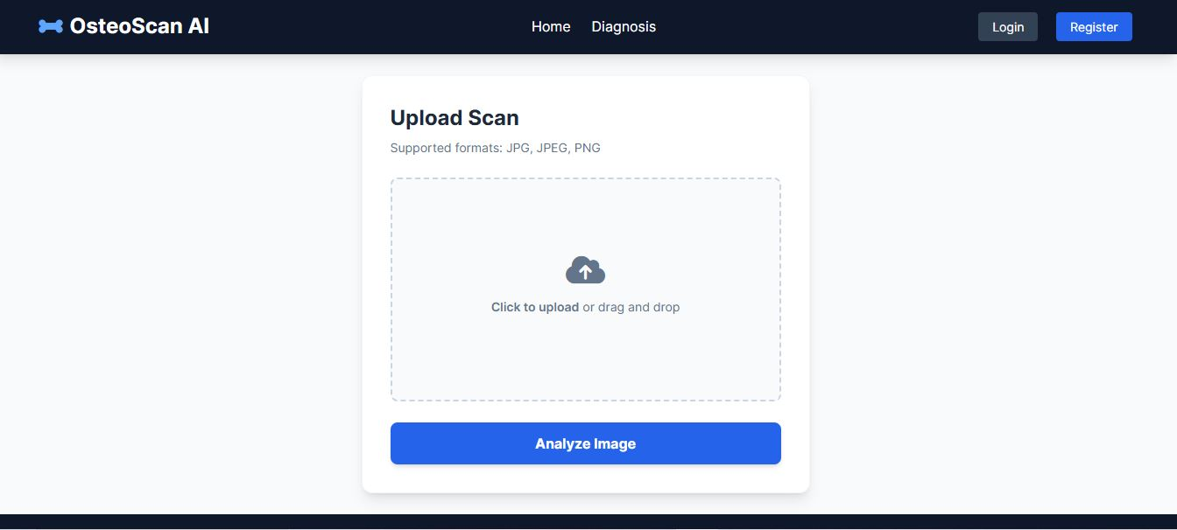
OUTPUT

Slide 13
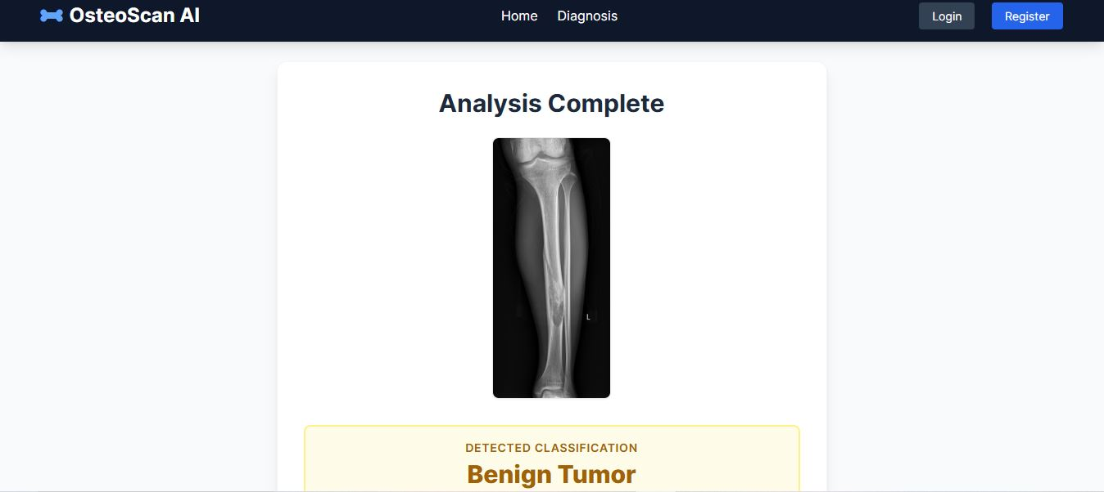
OUTPUT

Slide 14
CONCLUSION
This project proposes an advanced Explainable AI-based framework for bone tumor detection using hybrid deep learning architectures.
By integrating ResNet, EfficientNet, and Vision Transformers with enhanced preprocessing and visualization techniques, the system addresses limitations of existing methods.
The proposed solution aims to deliver higher accuracy, interpretability, and reliability, making it a valuable clinical decision-support tool for early bone tumor diagnosis.

Slide 15
REFERENCES
P. Krishnamoorthy and G. Madhurasree, “Feature Extraction Based Machine Learning Approach for Bone Cancer Detection,” Asian Journal of Engineering and Applied Technology, vol. 12, no. 2, pp. 1–6, 2023.
T. Singh and K. Ostrom, “Application of a Deep Learning Model for Effective Diagnosis of Osteosarcoma,” Journal of Student Research, vol. 13, no. 3, 2024.
R. F. Meem and K. T. Hasan, “Osteosarcoma Tumor Detection Using Transfer Learning Models,” arXiv Preprint, 2023.
Borji, G. Kronreif, B. Angermayr, and S. Hatamikia, “Advanced Hybrid Deep Learning Model for Enhanced Classification of Osteosarcoma Histopathology Images,” arXiv Preprint, 2024.
M. J. Belue, S. Harmon, D. Yang, J. An, and S. Gaur, “Deep Learning-Based Detection and Classification of Bone Lesions on Staging Computed Tomography,” Academic Radiology, vol. 31, no. 6, pp. 2424–2433, 2024.

Slide 16
THANK YOU

